Slide 1
Distributional Property Estimation
Past, Present, and Future
Gregory Valiant
(Joint work w. Paul Valiant)

Slide 2
Distributional Property Estimation
Given a property of interest, and access to independent draws from a fixed distribution D,
how many draws are necessary to estimate the property accurately?
We will focus on symmetric properties.
Definition: Let Δ be set of distributions over {1,2,…n}
Property π: Δ → R is symmetric, if invariant to
relabeling support: for permutation σ, π(D)=π(D_{σ})
e.g entropy, support size, distance to uniformity, etc.
For properties of pairs of distributions: distance metrics, etc.

Slide 3
Symmetric Properties
`Histogram’ of a distribution:
Given distribution D h_{D}: (0,1] -> N
h(x):= # domain elmts of D that occur w. prob x
e.g. Unif[n] has h(1/n)=n, and h(x)=0 for all x≠1/n
Fact: any “symmetric” property is a function of only h
e.g. H(D)=Σ_{x:h(x)≠0} h(x) x log x Support(D)=Σ_{x:h(x)≠0} h(x)
‘Fingerprint’ of set of samples [aka profile, collision stats]
f=f₁,f₂,…, f_{k} f_{i}:=# elmts seen exactly i times in the sample
Fact: To estimate symmetric properties, fingerprint contains all useful information.

Slide 4


The Empirical Estimate
“fingerprint” of sample:
i.e. ~120 domain elements
seen once, 75 seen twice,..
Entropy:
H(D)=Σ_{x:h(x)≠0} h(x) x log x
1/k
6/k
8/k
13/k
15/k
2/k
5/k
7/k
12/k
14/k
3/k
4/k
9/k
10/k
11/k
log(2/k)⋅
z(2/k)⋅
log(5/k)⋅
z(5/k)⋅
log(6/k)⋅
z(6/k)⋅
log(7/k)⋅
z(7/k)⋅
log(8/k)⋅
log(3/k)⋅
z(8/k)⋅
z(3/k)⋅
log(4/k)⋅
z(4/k)⋅
log(9/k)⋅
log(1/k)⋅
z(9/k)⋅
z(1/k)⋅
log(10/k)⋅
z(10/k)⋅
log(11/k)⋅
z(11/k)⋅
log(15/k)⋅
log(12/k)⋅
z(15/k)⋅
z(12/k)⋅
log(13/k)⋅
z(13/k)⋅
log(14/k)⋅
z(14/k)⋅
Better estimates? Apply something other than log to the empirical distribution

Slide 5
Linear Estimators
Most estimators considered over past 100+ years:
“Linear estimators”
c₁⋅
d₁
+ c₂⋅
d₂
+ c₃⋅
d₃
+ ⋅ ⋅ ⋅
Output:
What richness of algorithmic machinery is necessary to effectively estimate these properties?

Slide 6



Finding the Best Estimator
Searching for Better Estimators
Variance
s.t. for all distributions p over [n]
Bias
“Expectation of estimator z applied to k samples from p is within ε of H(p)”
Variance

Slide 7
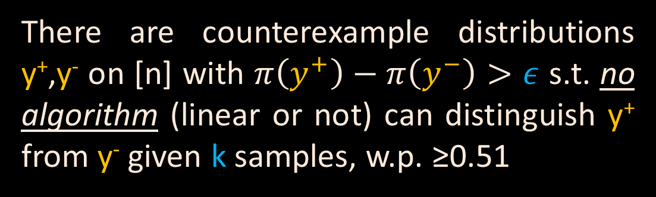
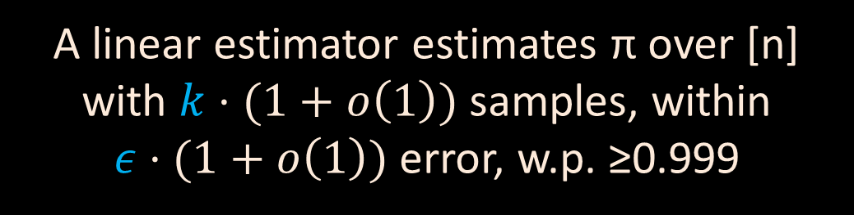
Surprising Theorem [VV’11]
Thm:
Given parameters n,k,ε, and a linear property π
Either
OR

Slide 8
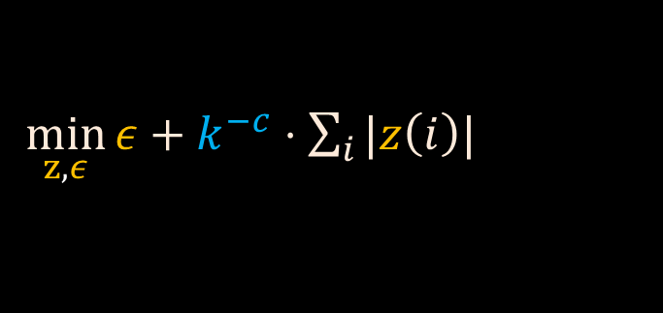

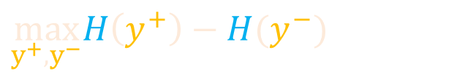
Proof Idea: Duality!!
“Find estimator z:
Minimize ε, s.t.
expectation of estimator z applied to
k samples from p is within ε of H(p)”
s.t. for all dists. p over [n]
“Find lower bound instance y⁺,y⁻
Maximize H(y⁺)-H(y⁻) s.t.
expected fingerprint entries given k samples from y⁺,y⁻ match to within k^{1-c} “”
→for y⁺,y⁻ dists. over [n]
s.t. for all i, E[f⁺_{i}] – E[f⁻_{i}] ≤ k^{1-c}

Slide 9
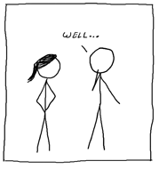
So…do these estimators work in practice?
Maybe unsurprising, since these estimators are
defined via worst worst-case instances.
Next part of talk: more robust approach.

Slide 10

Estimating the Unseen
Given independent samples from a distribution (of discrete support):
Empirical distribution ↔ optimally approximates seen portion of distribution
What can we infer about the unseen portion?
How can inferences about the unseen portion yield better estimates of distribution properties?
D

Slide 11

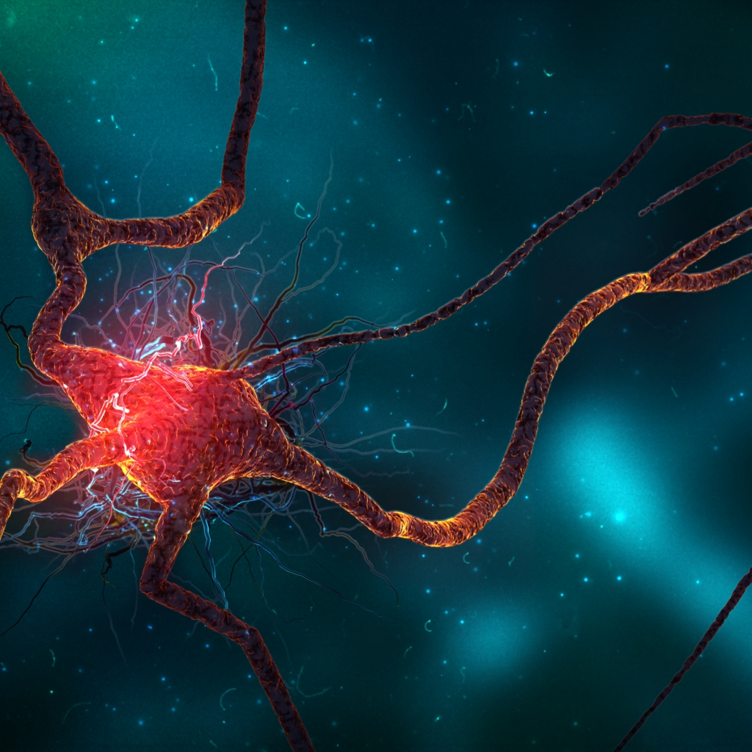

Some concrete problems
Q1: Given a length n vector, how many indices must we look at to estimate # distinct elements, to +/- εn (w.h.p)? [distinct elements problem]
Q2: Given a sample from D supported on {1,…,n}, how large a sample required to estimate entropy(D) to within +/- ε (w.h.p)?
Q3: Given samples from D1 and D2 supported on {1,2,…,n}, what sample size is required to estimate Dist(D1,D2) to within +/- ε (w.h.p)?
…
Distinct
Elements
Entropy
Distance
Trivial
Previous
Answer
Ο(n)
[Bar Yossef et al.’01]
[P. Valiant, ‘08]
[Raskhodnikova et al. ‘09]
Ο(n)
[Batu et al.’01,’02]
[Paninski, ’03,’04]
[Dasgupta et al, ’05]
Ο(n)
[Goldreich et al. ‘96]
[Batu et al. ‘00,’01]
a
c
a
b
c
n
n
log n
Θ( )
[VV11/13]
O(n logn)
vs
…
…
Notes:
Stone-Weierstrass thm

Slide 12

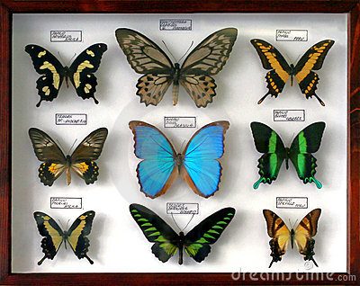
Fisher’s Butterflies
Turing’s Enigma Codewords
How many new species if I observe for another period?
Probability mass of
unseen codewords
f₁- f₂+f₃-f₄+f₅-…
f₁ / (number of samples)
+
-
+
-
+
-
+
-
+
-
+
-
-
+
+
(“fingerprint” of the samples)
Notes:
Striking examples of specific things one can easily say about the unseen portion

Slide 13
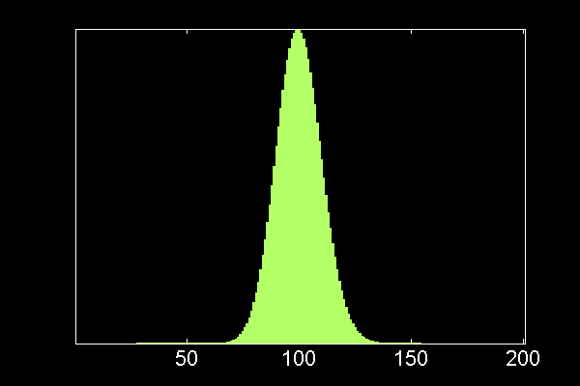
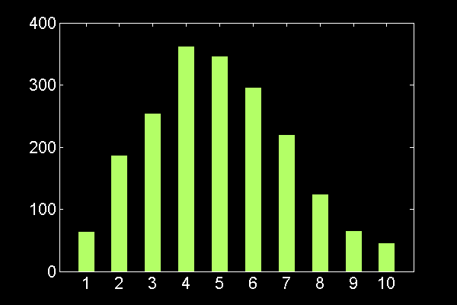
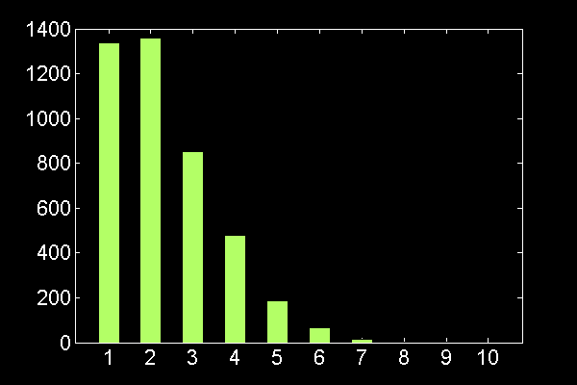
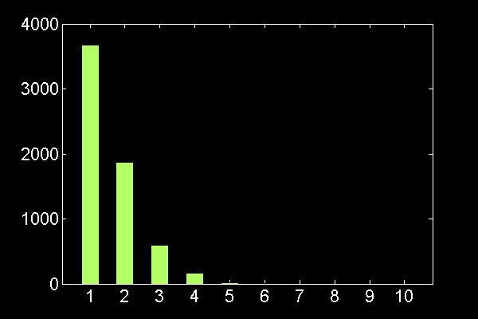
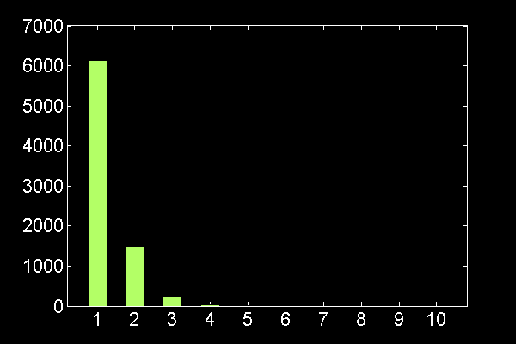
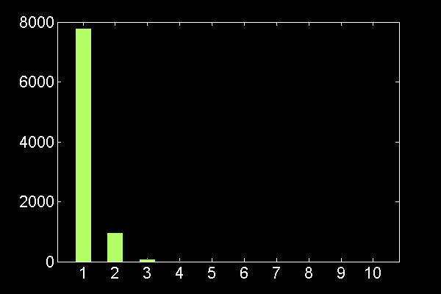
Reasoning Beyond the Empirical Distribution
Fingerprint based on sample of size k
Fingerprint based on sample of size 10000
Notes:
Aggressively push things to the unseen portion.

Slide 14
Linear Programming
“Find distributions whose expected fingerprint is close to the observed fingerprint of the sample”
Entropy
Feasible Region
Distinct Elements
Other Property
Must show diameter of feasible region is small!!
Θ(n/ log n) samples, and OPTIMAL
Notes:
diamter corresponds to error.
distributions consistent with what one has observed.

Slide 15
Linear Programming (revisited)
histogram
“Find distributions whose expected fingerprint is close to the observed fingerprint of the sample”
Thm: For sufficiently large n, and any constant c>1, given
c n / log n ind. draws from D, of support at most n, with prob > 1-exp(-Ω(n)), our alg returns histogram h’ s.t.
R(h_{D}, h’) < O (1/c^{1/2})
Additionally, our algorithm runs in time linear in the number of samples. R(h,h’): Relative Wass. Metric: [sup over functions f s.t. |f’(x)|<1/x, …]
Corollary: For any ε > 0, given O(n/ε² log n) draws from a distribution D of support at most n, with prob > 1-exp(-Ω(n)) our algorithm returns v s.t.
|v-H(D)|<ε
Notes:
diamter corresponds to error.
distributions consistent with what one has observed.

Slide 16
So…do the estimators work in practice?
YES!!

Slide 17
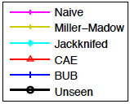
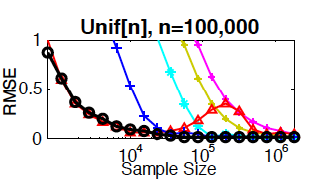
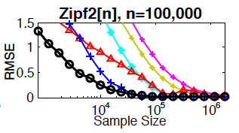
Performance in Practice (entropy)
Zipf: power law distr.
p_{j} α 1/j (or 1/j^{c})

Slide 18
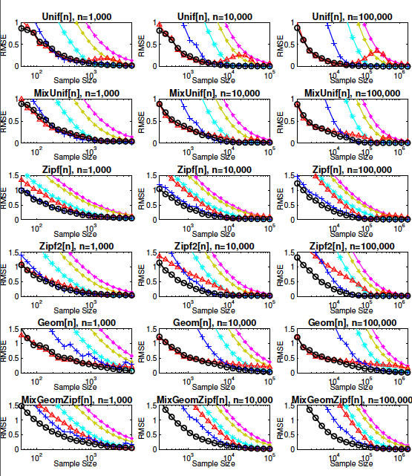
Performance in Practice (entropy)

Slide 19
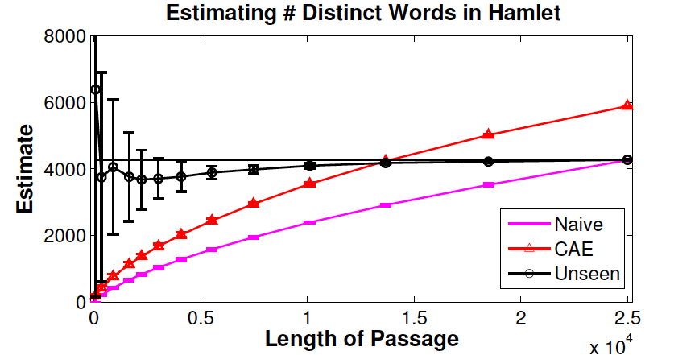
Performance in Practice (support size)
Task: Pick a (short) passage from Hamlet, then estimate # distinct words in Hamlet

Slide 20
The Big Picture
[Estimating Symmetric Properties]
Estimating Unseen
“Linear estimators”
Linear Programming
c₁⋅
f₁
+ c₂⋅
f₂
+ c₃⋅
f₃
+ ⋅ ⋅ ⋅
Substantially more robust
Both optimal (to const. factor) in worst-case,
“Unseen approach” seems better for most inputs
(does not require knowledge of upper bound on
support size, not defined via worst-case inputs,…)
Can one prove something beyond the “worst-case” setting?

Slide 21
Back to Basics
Hypothesis testing for distributions:
Given ε>0,
Distribution P = p₁ p₂ …
samples from unknown Q
Decide: P=Q versus ||P-Q||₁ > ε

Slide 22
Prior Work
Unknown Distribution
Is it P?
Or >ε-far from P?
Data needed
Pearson’s chi-squared test: >n
Batu et al. O(n^{1/2} polylog n/ε⁴)
Goldreich-Ron: O(n ^{1/2}/ε⁴)
Paninski: O(n ^{1/2}/ε²)
???
Type of input: distribution over [n]
Uniform distribution

Slide 23
Theorem
Instance Optimal Testing [VV’14]
∃ Fixed function f(P,ε) and constants c,c’:
Our tester can distinguish Q=P from|Q-P|₁ >ε using f(P,ε) samples (w. prob >2/3)
No tester can distinguish Q=P from |Q-P|₁>cε using c’f(P,ε) samples (w. prob >2/3)
^{-max}
|| P_{-ε} ||_{2/3}
f(P,ε)= max(1/ε , )
ε²
^{-max}
||P_{-ε} ||_{2/3} < ||P||_{2/3}
If P supported on <n elements, ||P||_{2/3} < n^{1/2/2}

Slide 24
The Algorithm (intuition)
Given P=(p₁,p₂,…), and Poi(k) samples from Q:
X_{i} = # times ith elmt occurs
Pearson’s chi-squared test
Our Test
(X_{i} – k p_{i})² - X_{i}
p_{i}^{2/3}
Σ_{i}
(X_{i} – k p_{i})² - k p_{i}
p_{i}
Σ_{i}
Replacing “kp_{i}” with “X_{i}” does not significantly change expectation, but reduces variance for elmts seen once.
Normalizing by p_{i}^{2/3} makes us more tolerant of errors in the light elements…
Notes:
Inner expression is unbiased estimator for (scaled version of) L2 distance squared. [Inner expression is very standard form; in fact, if even f you try to do anything else, you’ll end up, locally, with something of exactly this shape. Locally everything looks like L2 estimates.] Variance, however, is essentially also L2 squared. We want to estimate things linear in P, but instead simply the presence of large probability elements will swamp any information about small probability elements, hence we divide by some power of the probabilities. [Conversely, one could ask the lower bound question: answer is that the hardest case to test is when the discrepancy between p and q is proportional to p^(2/3). ]

Slide 25
Future Directions
Instance optimal property estimation/learning in other settings.
  Harder than identity testing---we leveraged knowledge of P to build tester.
  Still might be possible, and if so, likely to have rich theory, and lead to algorithms that work extremely well in practice.
  Still don’t really understand many basic property estimation questions, and lack good algorithms (even/especially in practice!)
  Many tools and anecdotes, but big picture still hazy

